Slide 1

FakeNews
Hoax news detector with mobile application
Notes:
This sample serves as a guideline on what should be covered on Go-to-Market / Sustainability Proposal

Slide 2
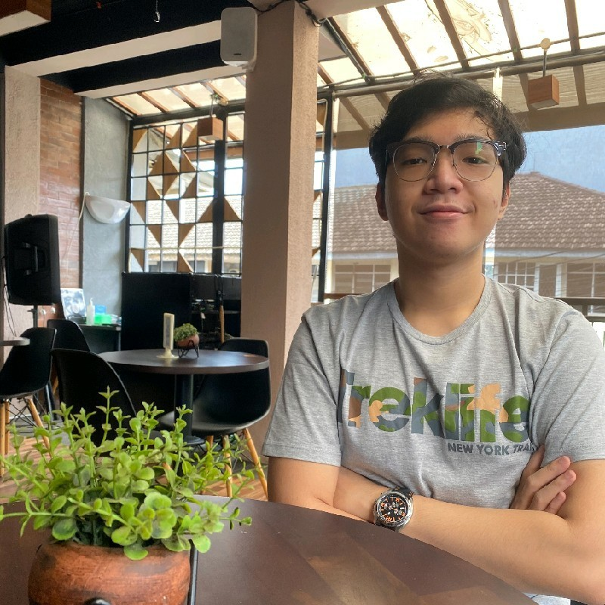
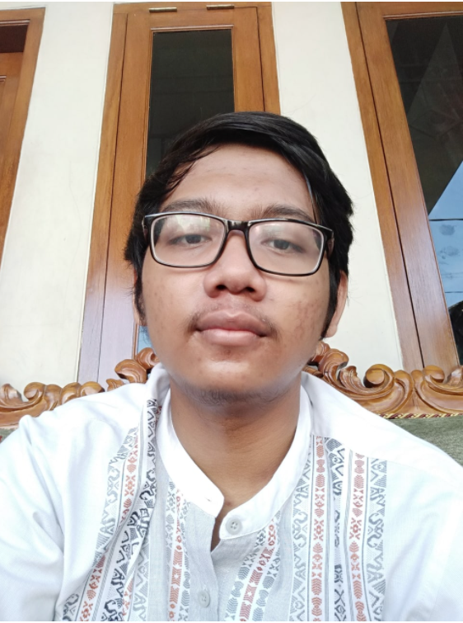
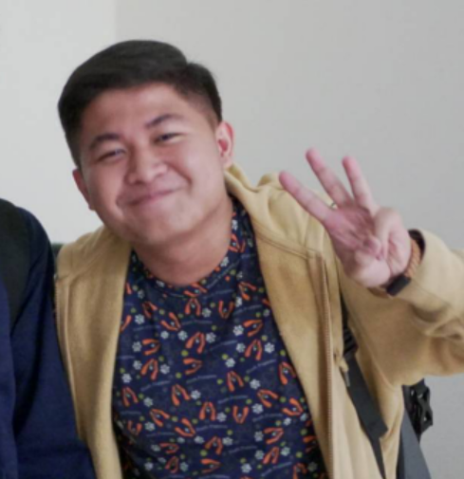
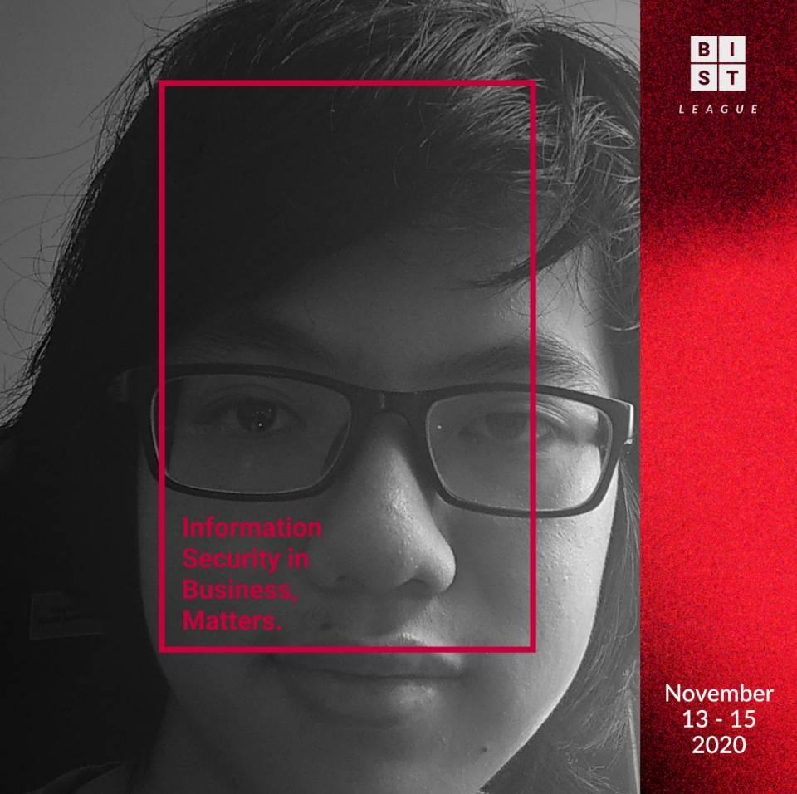
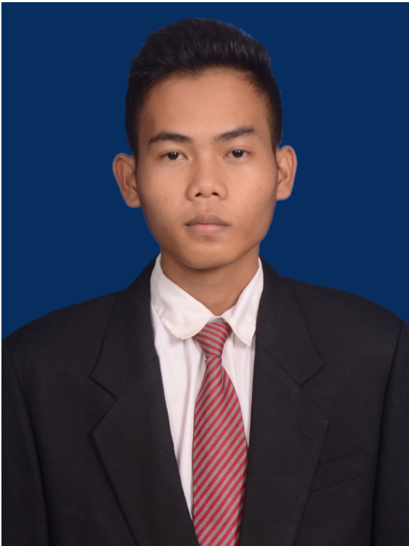
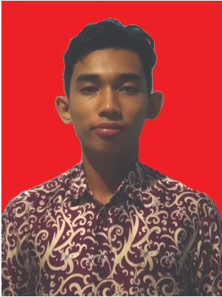
About Us
Cloud Computing Path
Ahmad Farhan Putra Kusuma
Maliki Karim
Universitas Islam Negeri Jakarta
Machine Learning Path
Aditya Tresnobudi
Adrian Timotheus (Leader)
Institut Teknologi Bandung
Mobile Development Path
Muhammad Rizal
Rezi Rahdianor
Universitas Lambung Mangkurat
Notes:
This sample serves as a guideline on what should be covered on Go-to-Market / Sustainability Proposal

Slide 3
Intro of your capstone team
Pasrah_Saja ( B21-CAP0431 ) consists of six people - two people from the same university and each path ( Android Developer, Cloud Computing, Machine Learning). Android Developer consist of Muhammad Rizal and Rezi Rahdianor, Cloud Computing consist of Ahmad Farhan Putra Kusuma and Maliki Karim, and lastly from Machine learning path consist of Aditya Tresnobudi and Adrian Timotheus Salim.
In this Capstone Project, we make a mobile app name FakeNews. this mobile app is a Fake News detector or in here we more familiar with hoax news. With this app everyone can cross-check whether a news is relevance or not.

Slide 4
Background

Slide 5
Background
What are you trying to achieve/solve?
So what we want to solve is that we know that nowadays there is a lot of fake news or what we call hoax news. we really want to solve how everyone can know that what they read in a news is a hoax or not. so that's what we want to achieve with this app
Is there anything been done before?
yes, for the public, someone has made a dataset for this application, but for us, this is the first time we have made it such as a machine learning model and its android application the different from the model that already on public, its mobile app.

Slide 6
Reason

Slide 7
Reason
We chose this Capstone Project and it is related to the business theme, because we see that all the information that is around us, we mostly consume from news portals, and this will be very impactful for people who do business, because they have to carefully look at the market so that they can act quickly in all situations
The problem that we want to overcome is the problem of convenience and practicality, because the main source of the problem of inaccuracy in detecting hoax news is that checking cannot be done easily.

Slide 8
Existing Result
Notes:
may

Slide 9
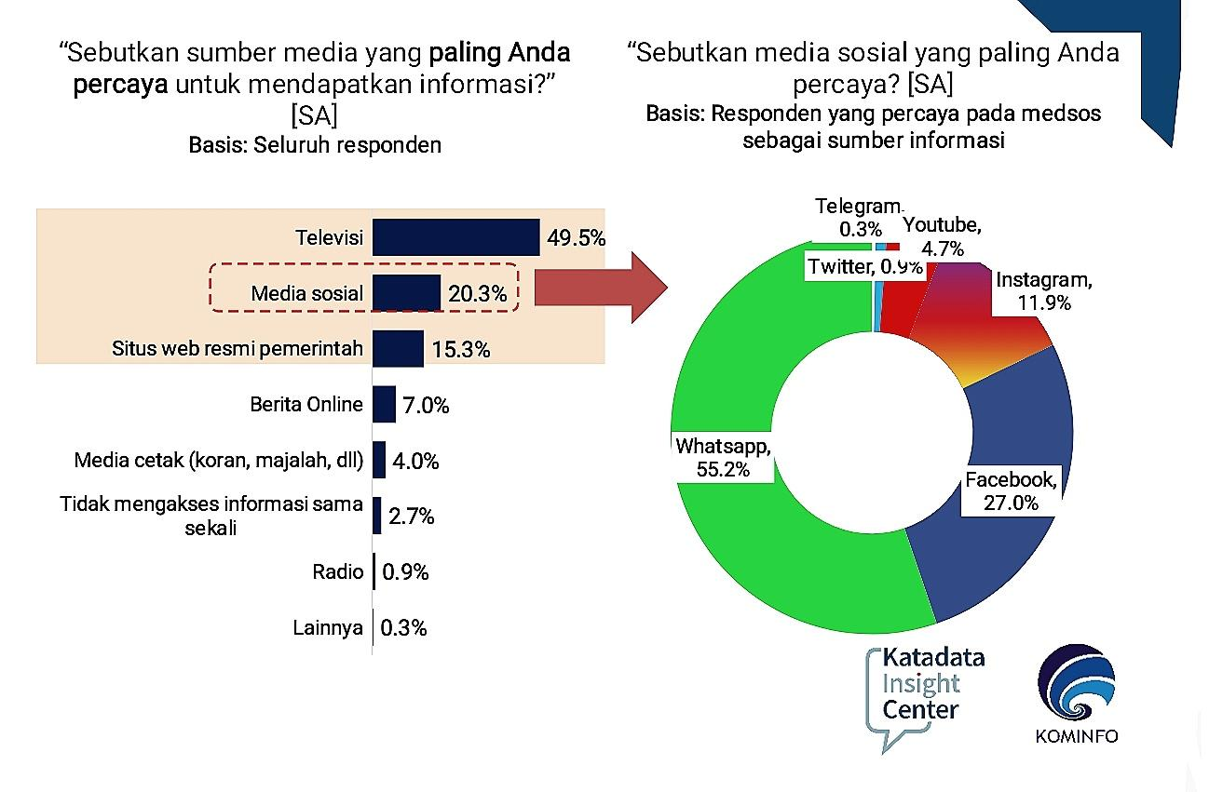
Existing Result

Slide 10
Implementation/Improvement
Notes:
may

Slide 11
Implementation/Improvement
Different from the other’s, our application implemented a mobile app, so its easier to access, and with the machine learning model that we use. we could know the accuracy about news that we want to cross-check
We chose this specific implementation because this method can solve the initial problem that we got, namely checking news quickly cannot be done easily

Slide 12
Result
Notes:
may

Slide 13
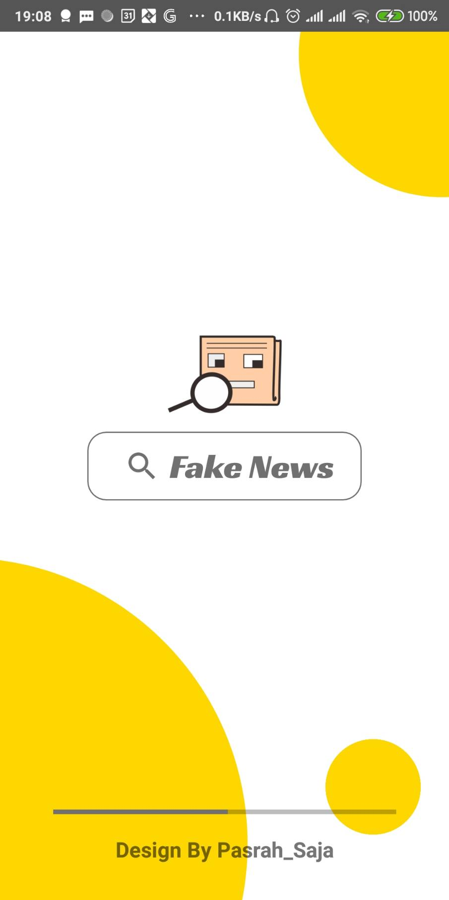
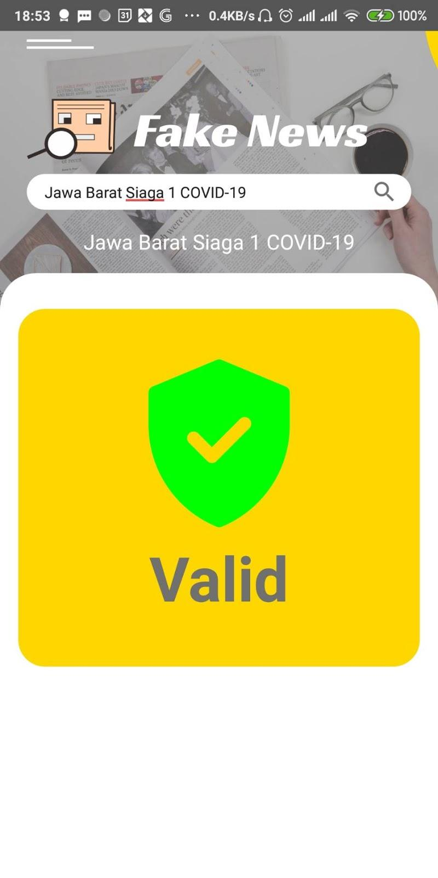
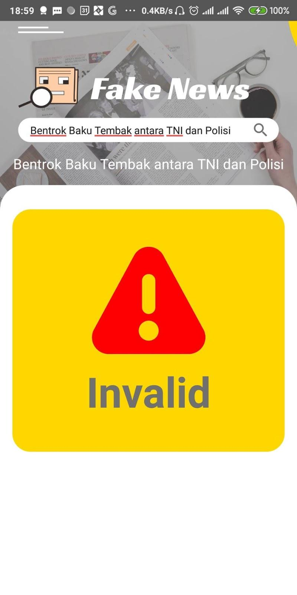

Screenshots of your app

Slide 14
Documentation
Notes:
may

Slide 15
Documentation
Machine Learning :
https://www.kaggle.com/clmentbisaillon/fake-and-real-news-dataset
https://firebase.google.com/docs/ml-kit
https://www.tensorflow.org/api_docs
Cloud computing and android :
https://firebase.google.com/codelabs/textclassification-android
https://firebase.google.com/docs/ml/android/use-custom-models?hl=id
https://firebase.google.com/docs/firestore/quickstart#android

Slide 16
Plan a local deployment of your project
Notes:
may

Slide 17
Project Milestones for 2021
Analysis how user respond to our app and get feedback from it
Integrated our app into bigquery so we can do future analysis from it
July
October
August
December
Fixing the bugs and add feature from feedback we got
Make an update to improve our app

Slide 18

Target Market or Personas
Age range | Profession | Roles | Specific Attributes or likings, hobbies
12 - 22 years old | Students & Collages Student | learning needs | Usually students look for news for their assignment needs to make sure the news is valid or can't use this application
23 - 55 years old | Politician, businessman, etc | looking for valid news | sometimes adults are looking for valid news or not. with this application you can check valid news

Slide 19
Business Pitch and Go-to-market proposal
https://drive.google.com/file/d/1NxZycg5PTj8SyVM1krVx7i-y3fXBQOui/view?usp=sharing
Notes:
may

Slide 20
Thank’s

